Slide 1
Structure of forsterite at extreme conditions using laser shock compression
Nara Anusonti-Inthra
Science and Mathematics Academy, Aberdeen High School
Prof. June Wicks and Patrick LaChapelle
Notes:
Hi I am Nara and I go to the SMA
This summer under the guidance of June and pat I studied the structure of forsterite….

Slide 2
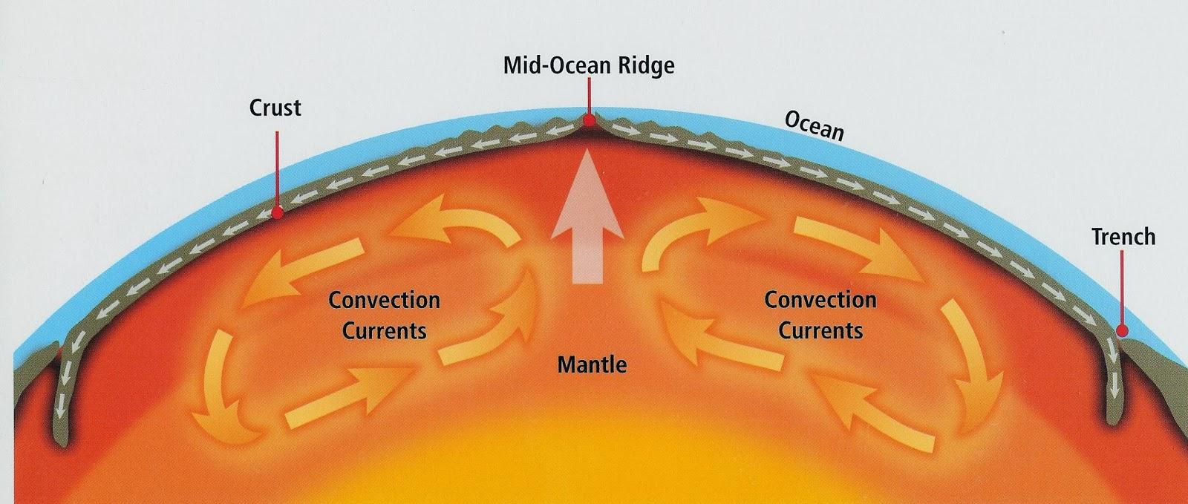
Forsterite
Main component of the mantles of rocky planets
Its phase transitions provide insight into the formation, evolution, and habitability of rocky exoplanets
Plays a role in shaping convection currents, influencing factors essential to habitable surface conditions
Its phase transitions at the high pressures of the mantle must be experimentally proven
Notes:
-Forsterite is a very important mineral to study in the field of planetary science
-It is a main component in the Earth’s upper mantle and expected to be in rocky exoplanets
-its phase transtions can tell us a lot about the formation evolution and habitability of rocky exoplanets
-mainly, plays a role in creating and shaping convection currents -> plate tectonics and magnetosphere -> surface conditions suitable to support life
-during the formation of a planet it also affects the cooling of the early magma ocean stage of planet formation, which contributes to geochemistry and thermal evolution of a planet
-the phase transitions of forsterite inside the earth’s mantle are a factor in deep earthquake generation, which are less damaging than earthquakes that occur closer to the surface, but affect a larger area
-the phase transitions of forsterite at these high pressures and temperatures are very hard to study and need to be experimentally proven
-an important phase transition that is predicted is incongruent melting

Slide 3
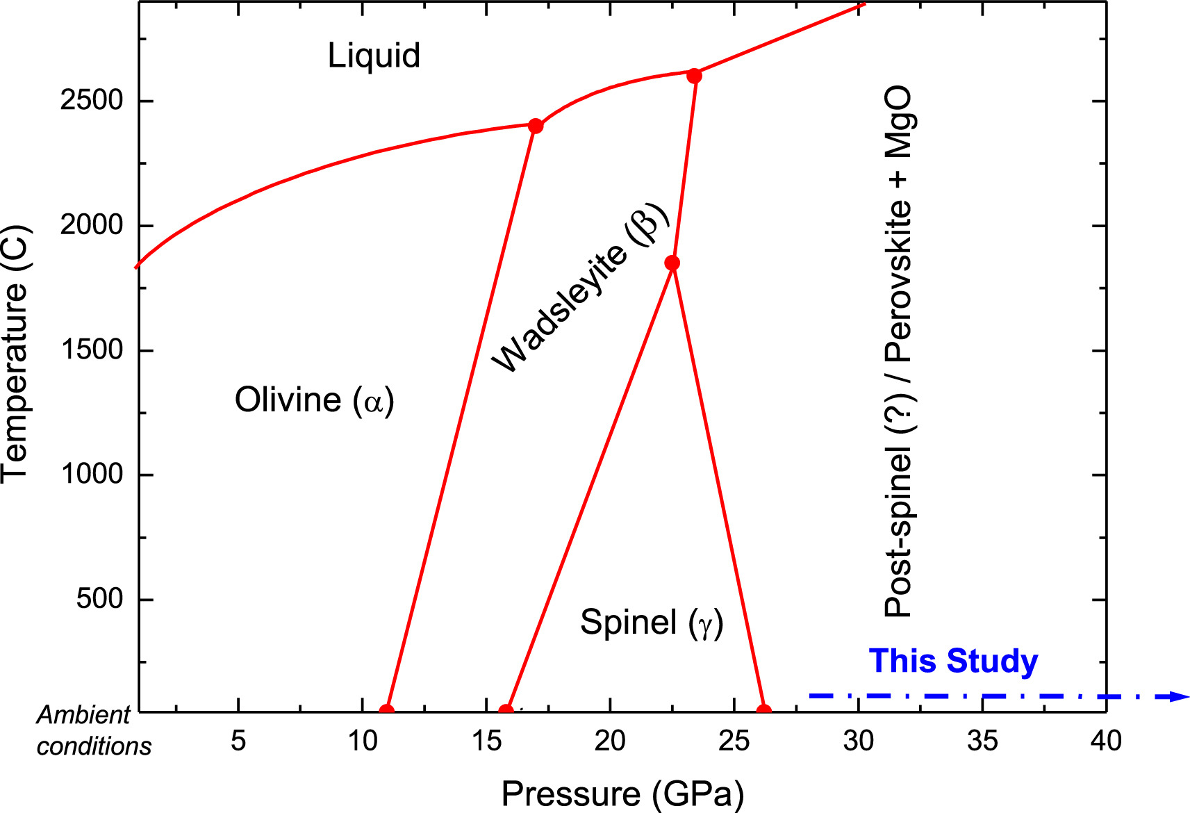
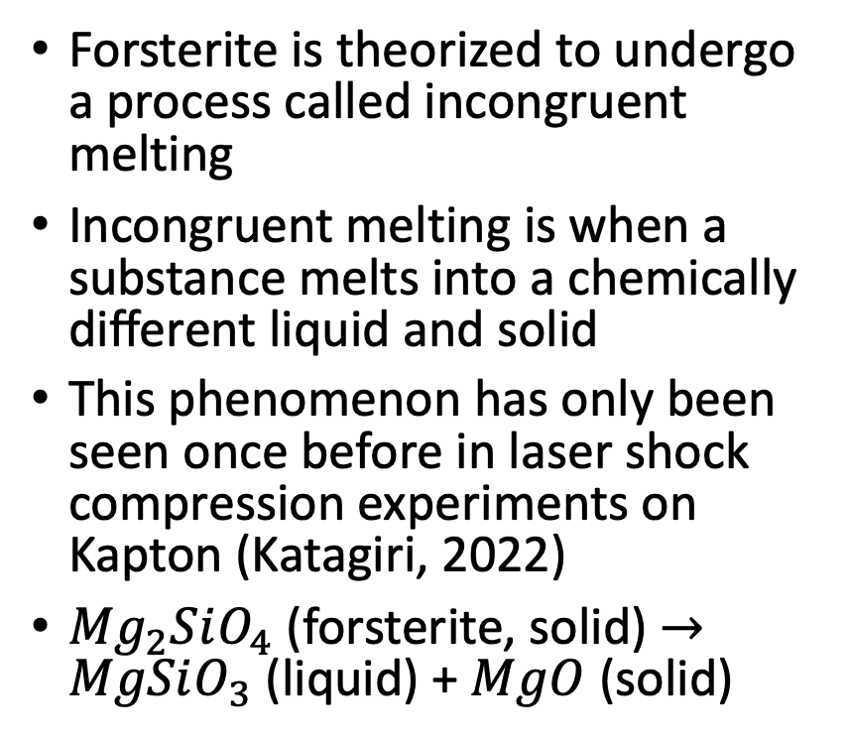
Incongruent melting
Forsterite is theorized to undergo a process called incongruent melting
Incongruent melting is when a substance melts into a chemically different liquid and solid
This phenomenon has only been seen once before in laser shock compression experiments on Kapton (Katagiri, 2022)
${Mg}_{2}SiO_{4}$ (forsterite, solid) $→MgSiO_{3}$ (liquid) + $MgO$ (solid)
Notes:
-one of these forsterite phase transitions is theorized to be incongruent melting
-melt and chemically decompose
-this is one of the many possible decompositions of forsterite
LIQUID SILICATE
-to prove this in the experiment we are looking for crystal MgO
-sometimes forsterite can rise to the surface from the mantle and here’s a picture of it crystalized in some basalt

Slide 4
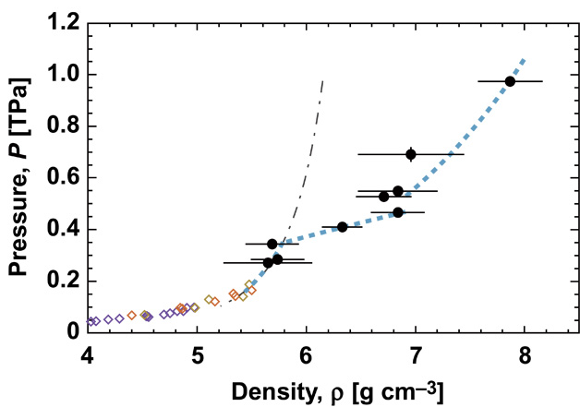
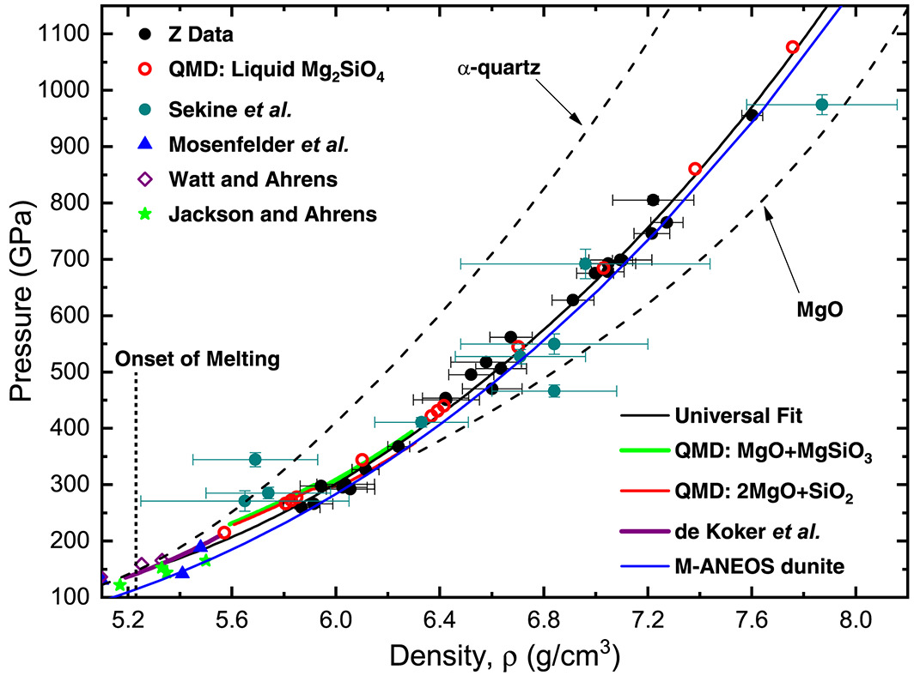
Previous studies
Evidence supporting incongruent melting has been found in only two studies, but when it occurs is currently inconclusive
Sekine et al. (2016) – measured density without XRD, found slope changes at 271 to 285 GPa that may be incongruent melting
Root (2018) – attempted to replicate Sekine et al, found forsterite completely melted after 200 GPa
Newman, PhD thesis (2018) – used XRD and found incongruent melting at 150 to 195 GPa
Sekine (2016)
Root (2018)
Notes:
-pressure range is currently inconclusive
-sekine et al shown on the right, they calculated a hugoniot for forsterite, a hugoniot is a pressure v density graph
-when there are no phase transitions happening the hugoniot is a smooth curve
-sekine found slope changes in their hugoniot as seen here which they attributed to incongruent melting at 271 to 285 GPa
-another study root in 2018 attempted to replicate Sekine’s results but didn’t find any slope changes in the hugoniot
-they then stated that since their hugoniot is smooth forsterite was already completely melted at the lowest pressure of their experiments (around where sekine et al started their experiments) so further experiments should look into a lower pressure range than in Sekine et al
-also mentioned that further studies should use x-ray diffraction, which is a much more accurate way of determining crystal structure than simply a density measurement
-lastly newman’s dissertation in 2018 used x-ray diffraction and found evidence for incongruent melt at a much lower pressure range, 150 to 195 GPa

Slide 5
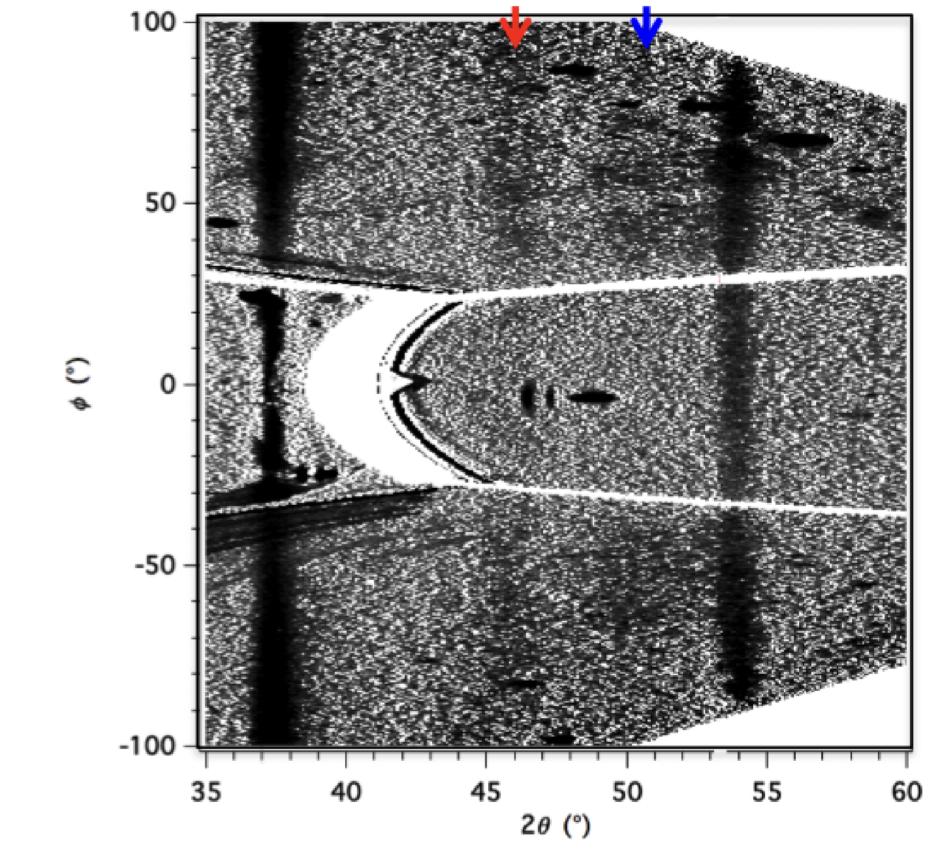
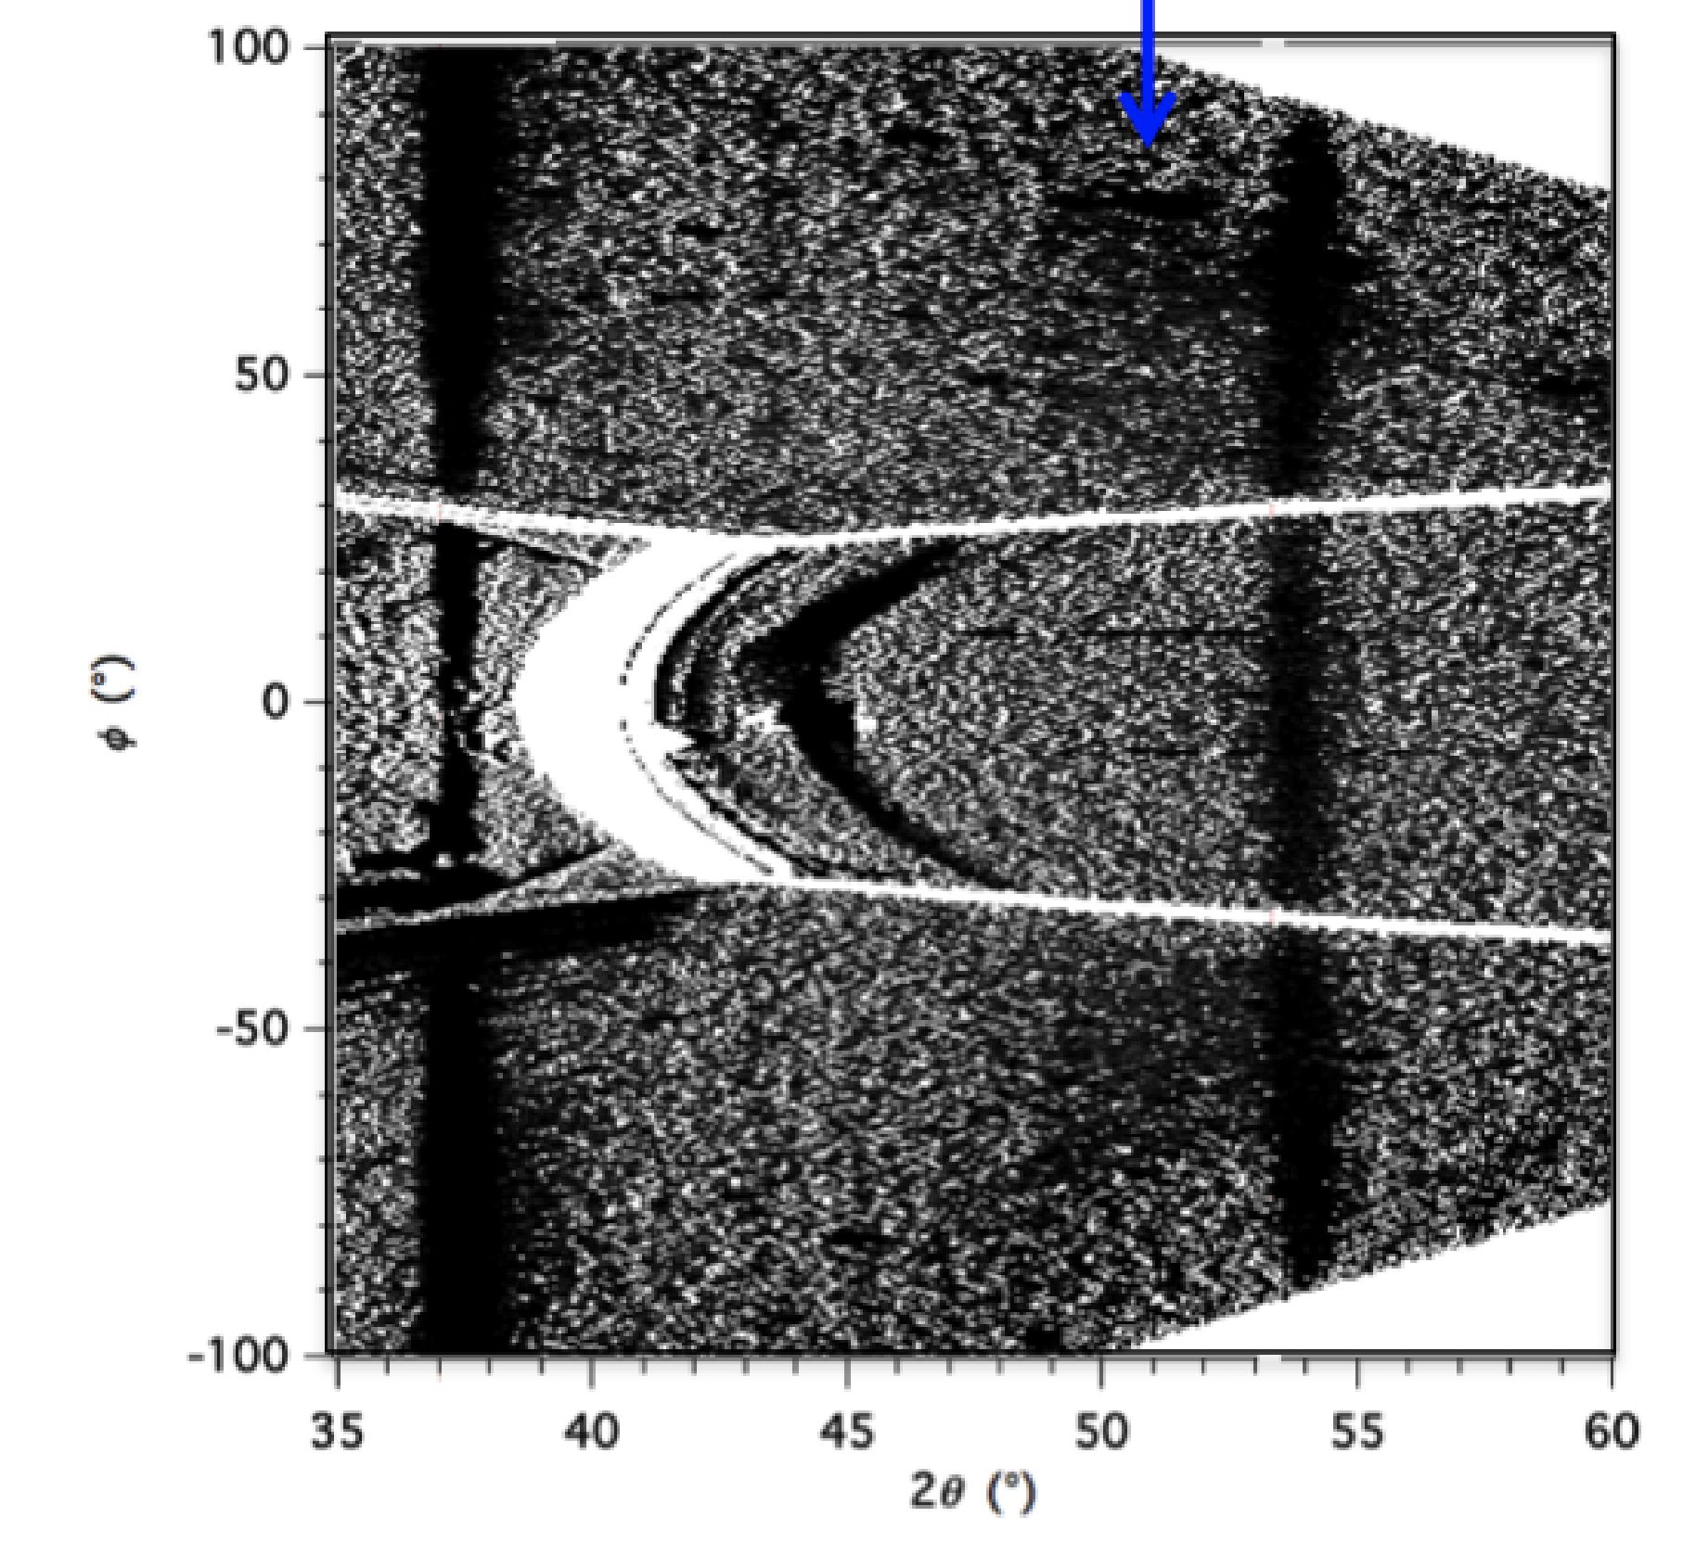
XRD pattern from Newman, PhD thesis (2018)
MgO
Fo melt
Fo melt
192 GPa
214 GPa
Notes:
-this is the results from Newman
-this is x-ray diffraction data, which I will explain later
-his results were that he found incongruent melting at 192 GPa, and he said this was because he saw a sharp MgO line, red arrow, and a fuzzy forsterite melt line blue line
-in the higher pressure shot the blue melted forsterite line is there but no MgO
-he then concluded that above 200 GPa forsterite is completely melted
-it agrees very well with Root, who concluded the same thing

Slide 6
Research question
2 XRD experiments (150 and 206 GPa) were conducted
Do either reflect incongruent melting?
If Newman is correct, there should be incongruent melting at 150 GPa and full melt at 206 GPa
If Sekine is correct, incongruent melting might not occur until 260 GPa

Slide 7
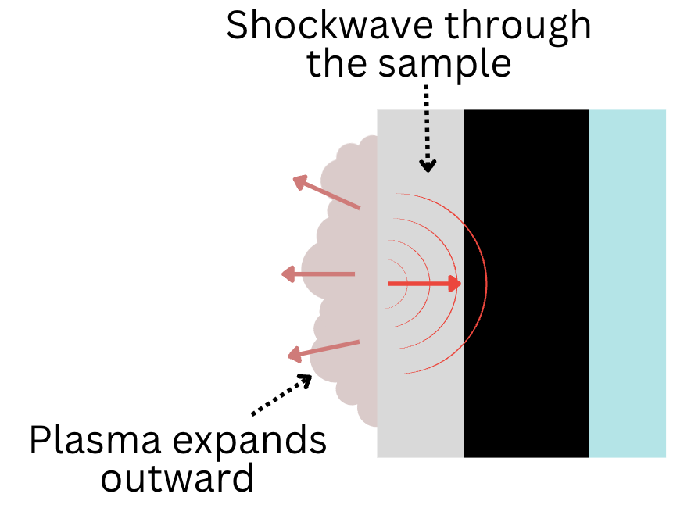
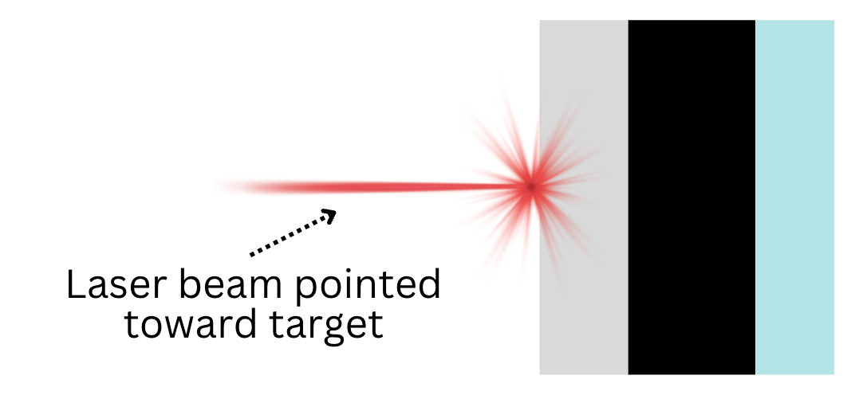
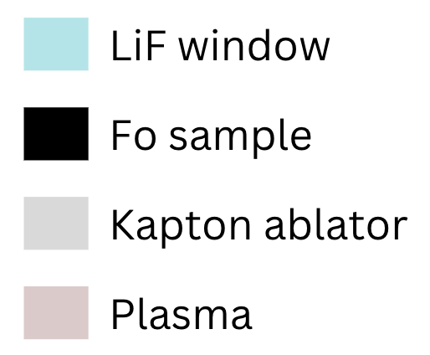
Laser shock compression
The extreme pressures needed for this experiment are generated using laser produced shock waves
The sample consisted of a 150 𝜇𝑚 thick Kapton ablator, 130 𝜇𝑚 of powdered forsterite, and 100 𝜇𝑚 of window material (LiF)
As the laser hits the sample, the ablator expands backwards, creating a uniform shock wave through the sample
Notes:
-to achieve the high pressures needed for this experiment we must use laser generated shock waves
-the laser we use is the Omega-EP laser from the university of Rochester
-sample is yadayada
-window is used for VISAR shock wave velocity measurements which are not currently analyzed
-here is a diagram of the sample setup
-and what happens is that the laser (red arrow) hits the ablator and it evaporates sending an even shock wave back through the sample, achieved the desired pressures

Slide 8
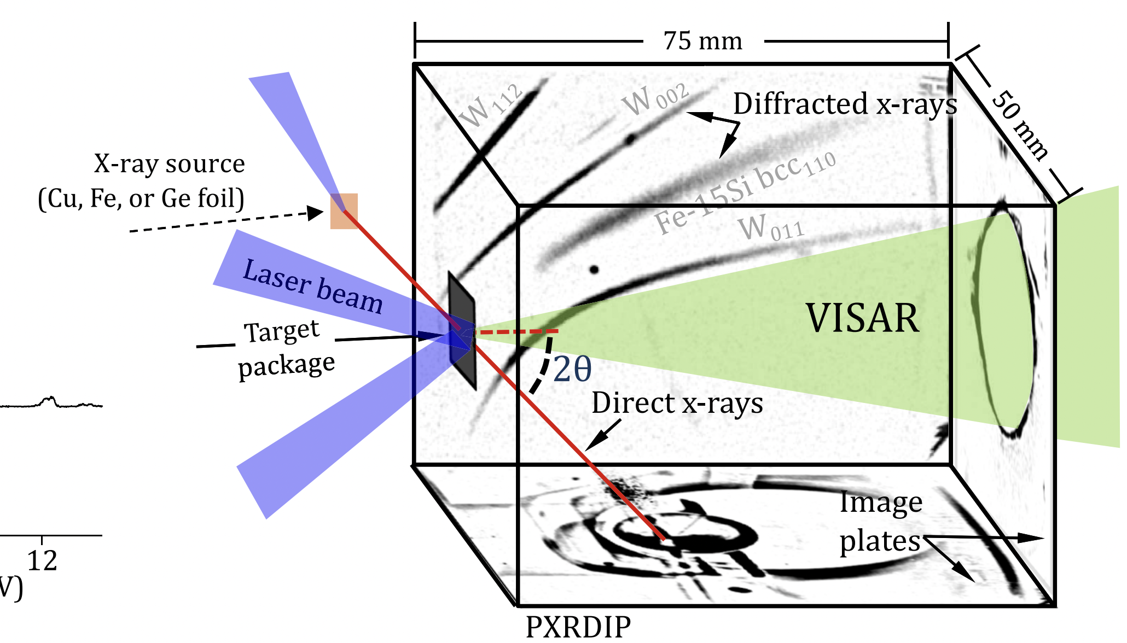
PXRDIP
Powder X-ray Diffraction Image Plates
X-rays are diffracted according to the structure of the sample, and then picked up by the image plates
The sample is held by a Ta (tantalum) pinhole, which is used for proper data alignment
Wicks (2018)
Notes:
-now that the sample is shocked to the required pressure, we determine the crystal structure using PXRDIP standing for …
-a laser generated Copper plasma sends x-rays through the sample
-these x-rays are diffracted according to structure and picked up by the box of image plates, and they will show as darker areas
-the sample is held in a tantalum pinhole, which focuses the x-rays on the sample
-the Ta pinhole also serves another use in data alignment since the image plates are not place exactly correctly
-x-rays from tantalum diffracting can also be seen on the PXRDIP, and as the way ta diffracts is well known and measured, the data can be calibrated properly

Slide 9
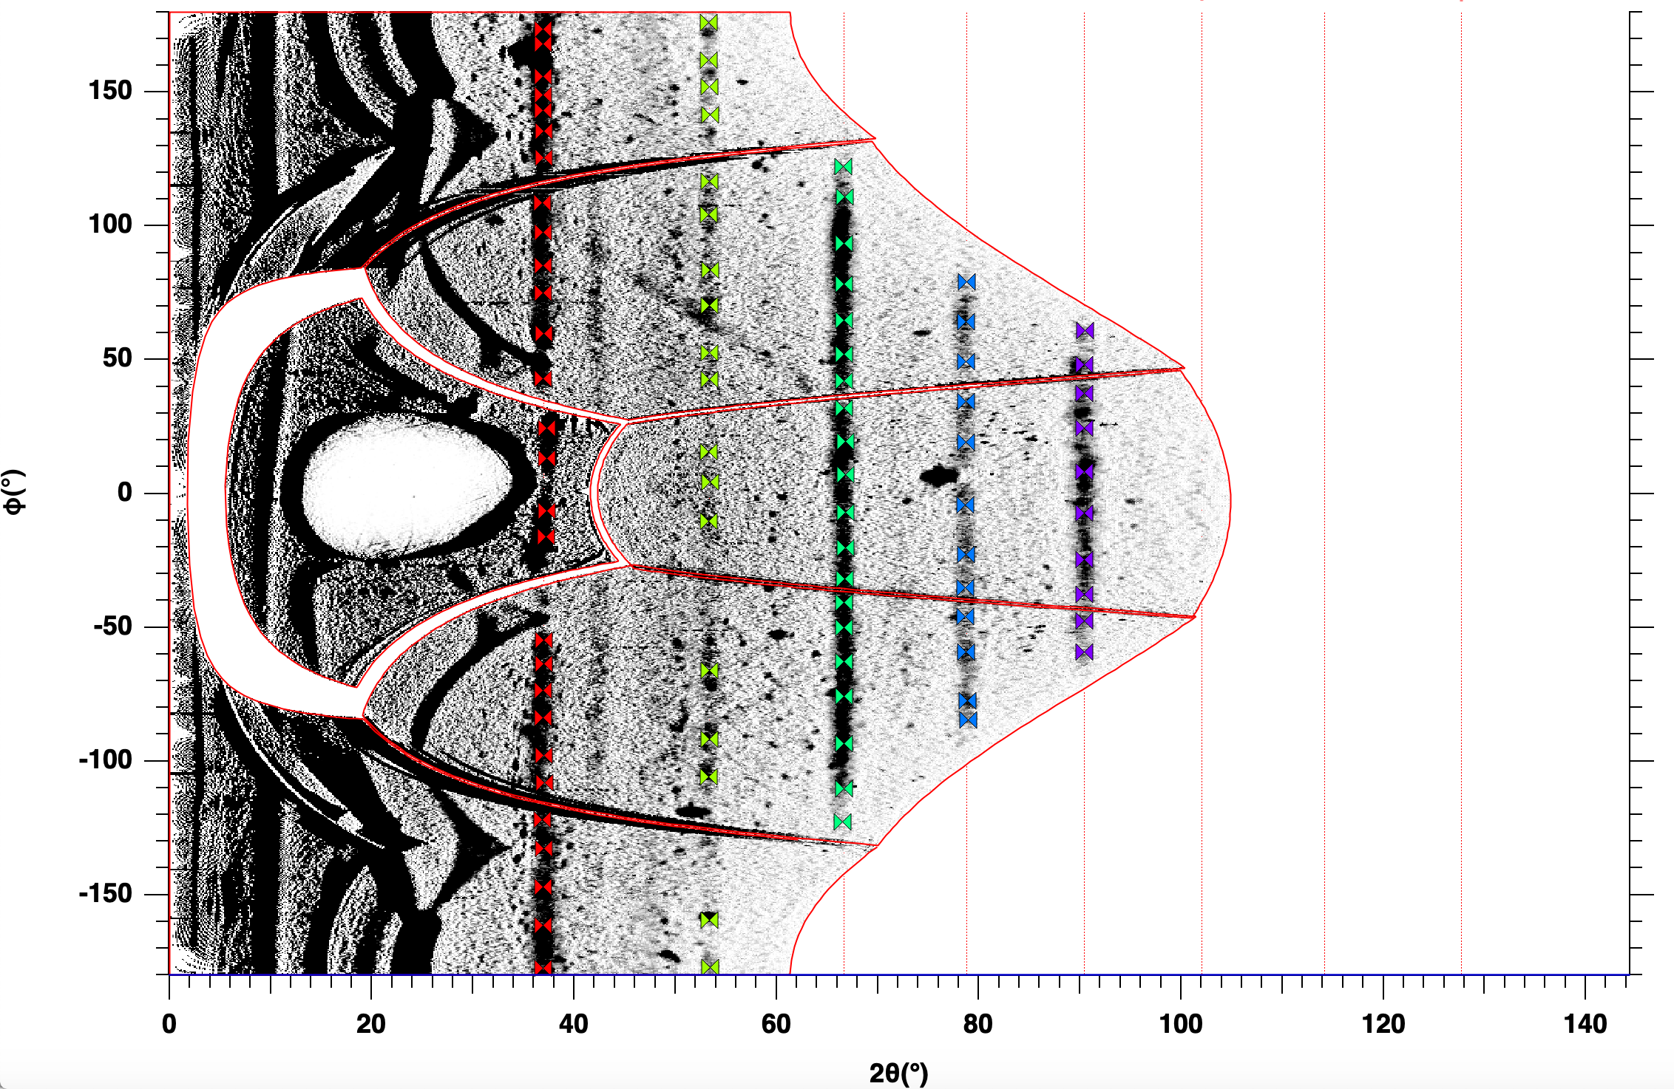
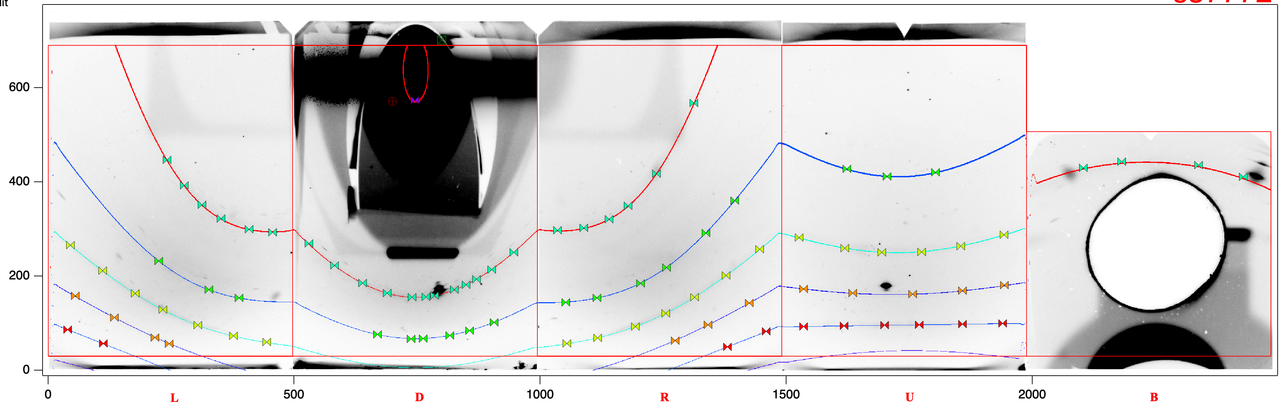
PXRDIP analysis (dewarping)
Must convert raw data (left) to warped polar data (right)
Use the Ta diffraction lines to calibrate the data (flags)

Slide 10
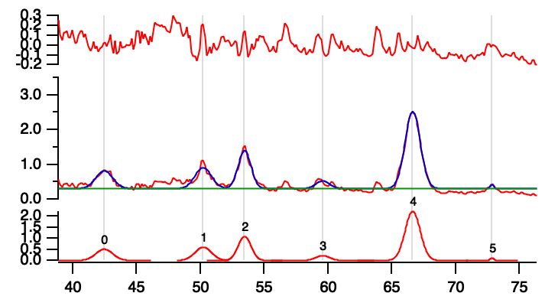
PXRDIP analysis
After integration along the azimuthal angle, diffraction peaks are found
Diffraction peaks are translated into d-spacing (inter-atomic spacing in the lattice)
Each material has a characteristic d-spacing and diffraction pattern
Notes:
-on the left is raw data from the PXRDIP, which is curved lines and then warped to a polar view with straight lines
-this is because we are translating the data from box space to polar space
-the flags are there like I said earlier to align the Ta peaks
-after it is aligned the diffraction peaks can be found, and these are the darker areas otherwise known as where the x-rays are concentrated
-because we used powdered forsterite these diffraction peaks are going to show up as lines as seen here
-we integrate up and down to get the exact location of these diffraction peaks
-these peaks and then translated into d-spacing
-this d-spacing can be used to identify which diffraction peak belongs with which material because each material has a unique d-spacing

Slide 11
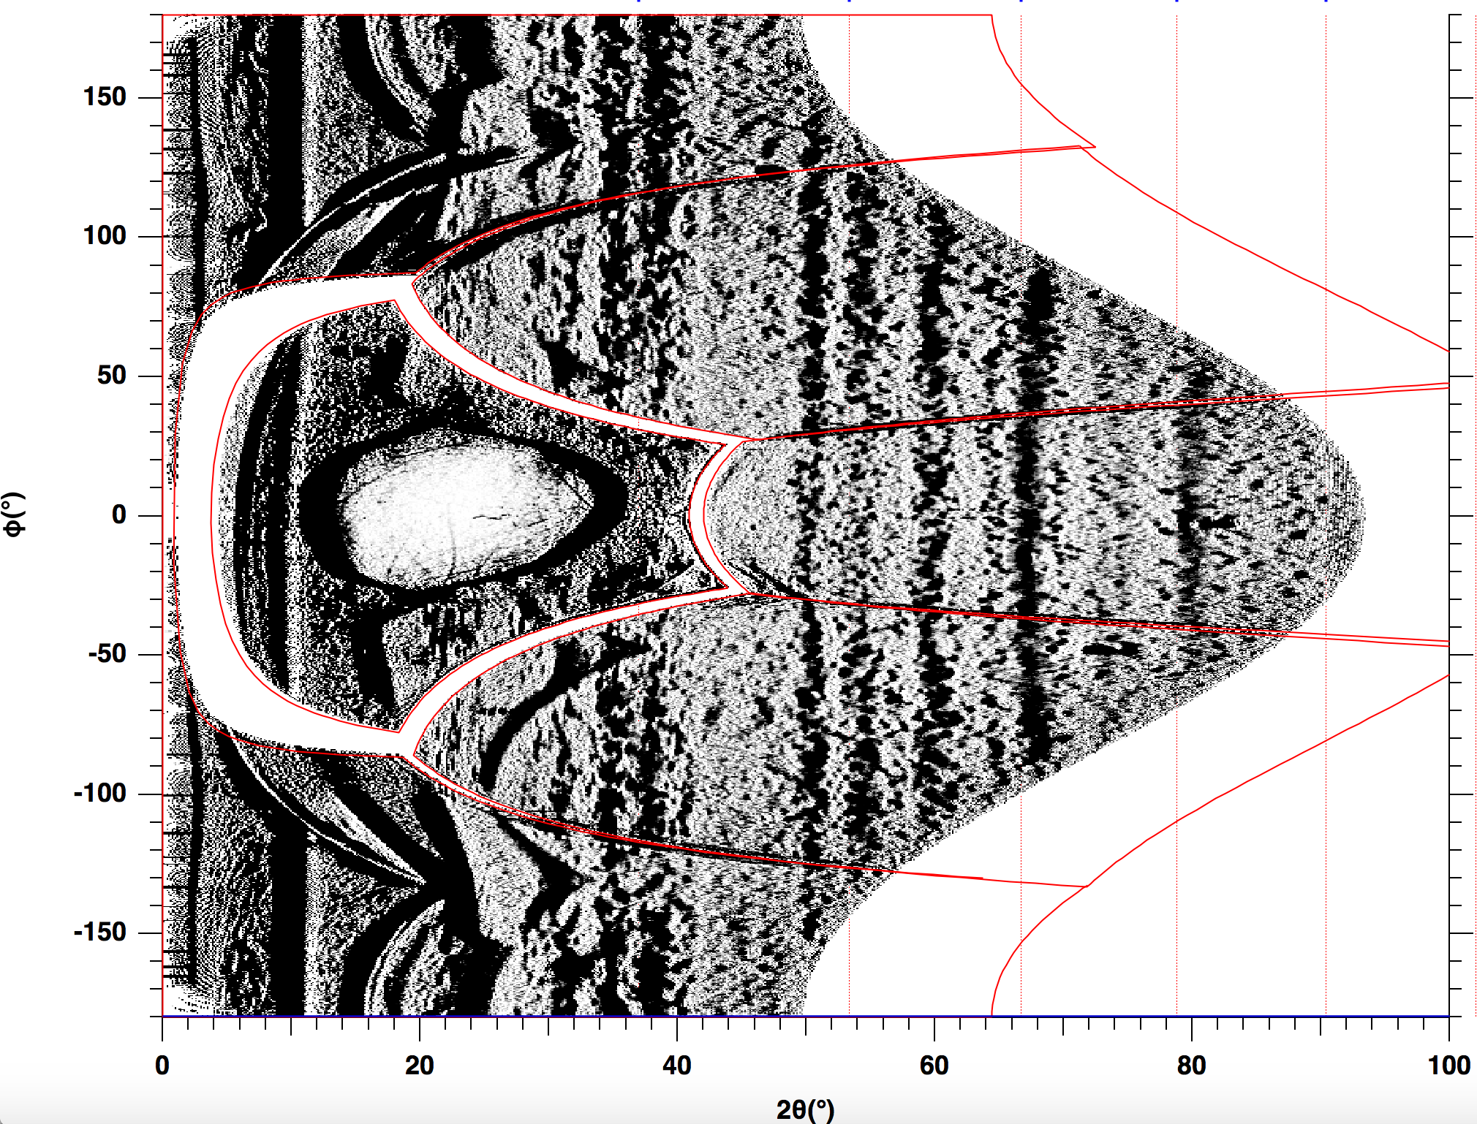
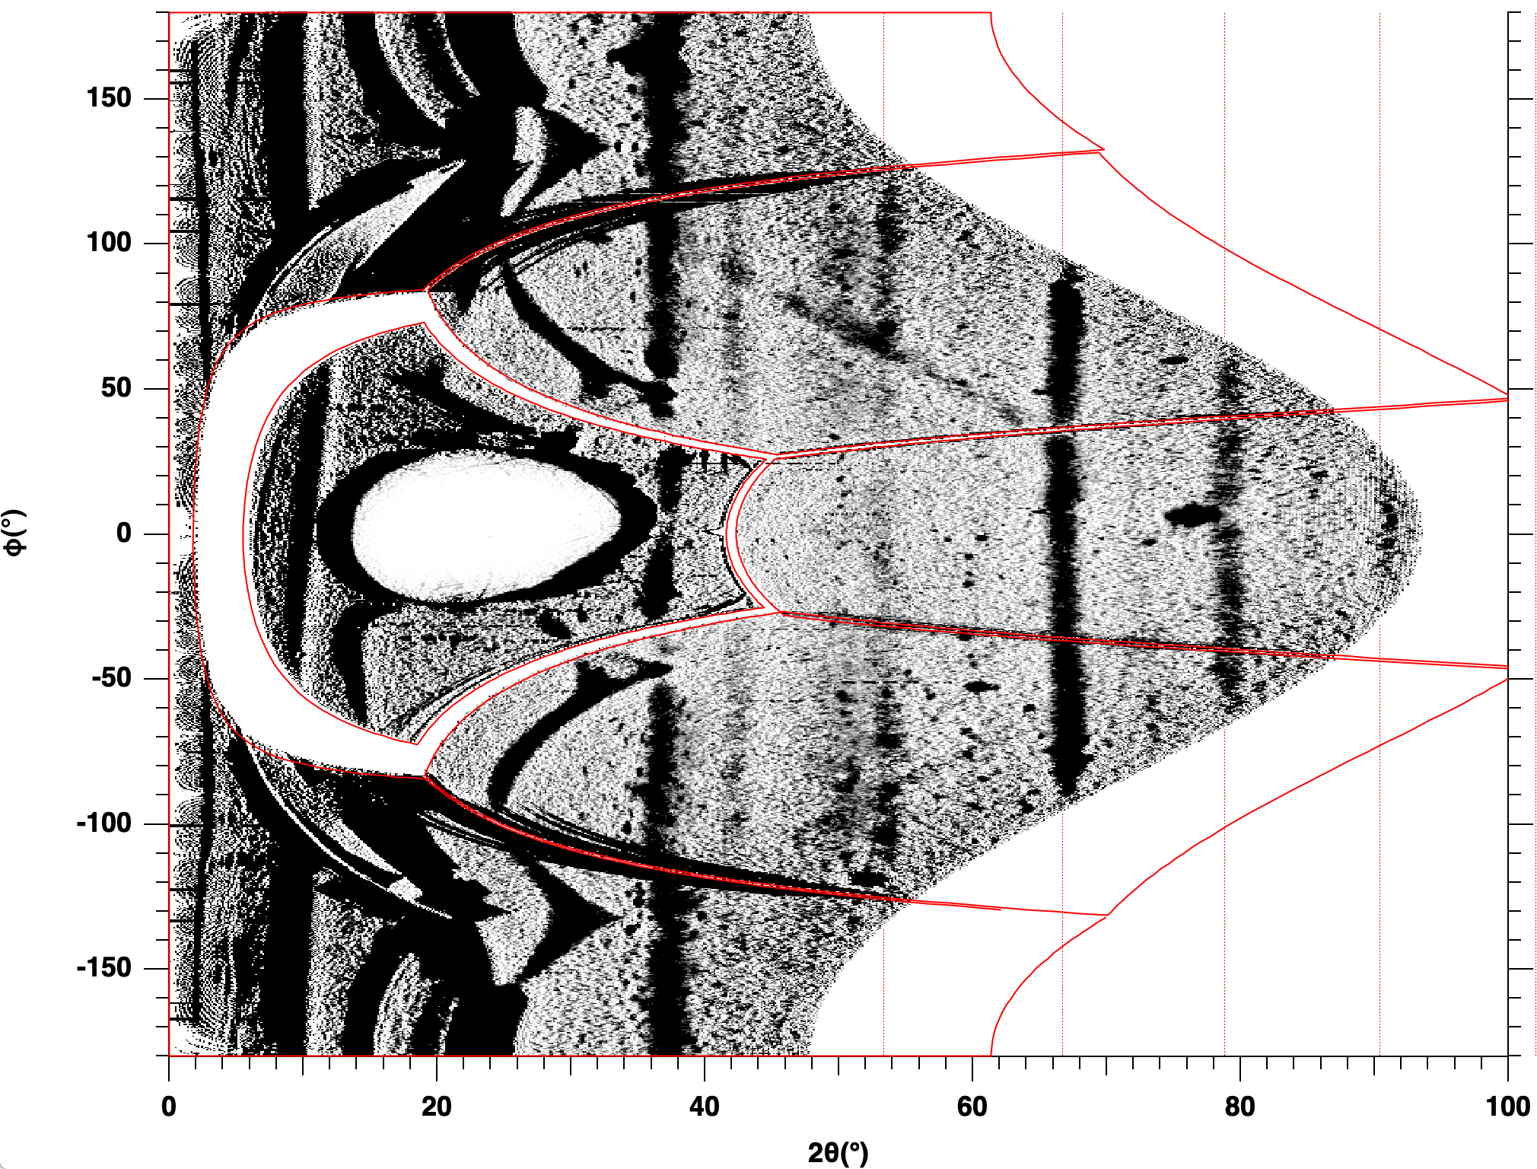
Results - PXRDIP
150 GPa
260 GPa
Notes:
Here are the results from the PXRDIP

Slide 12
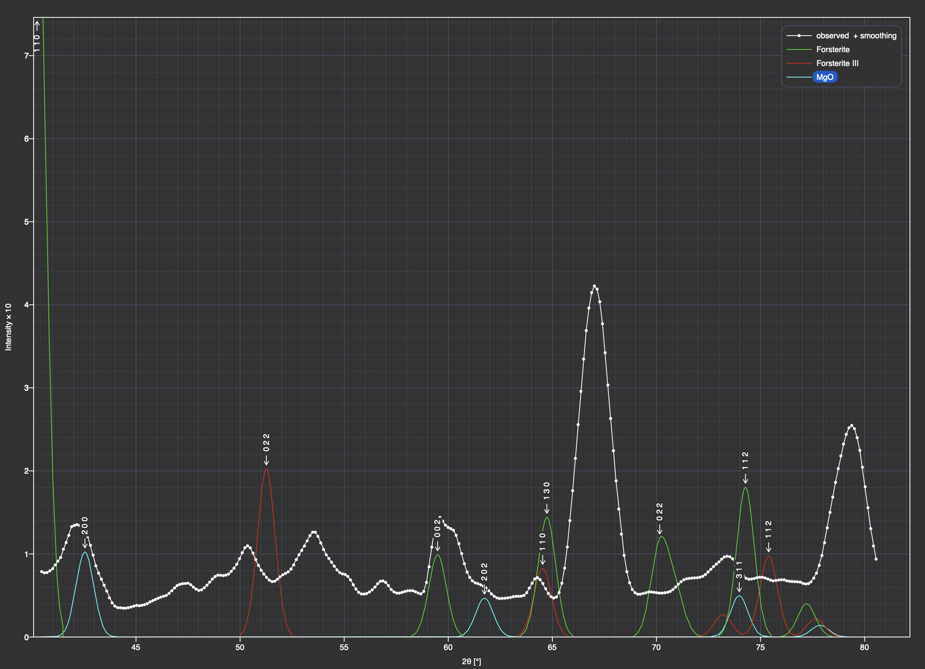
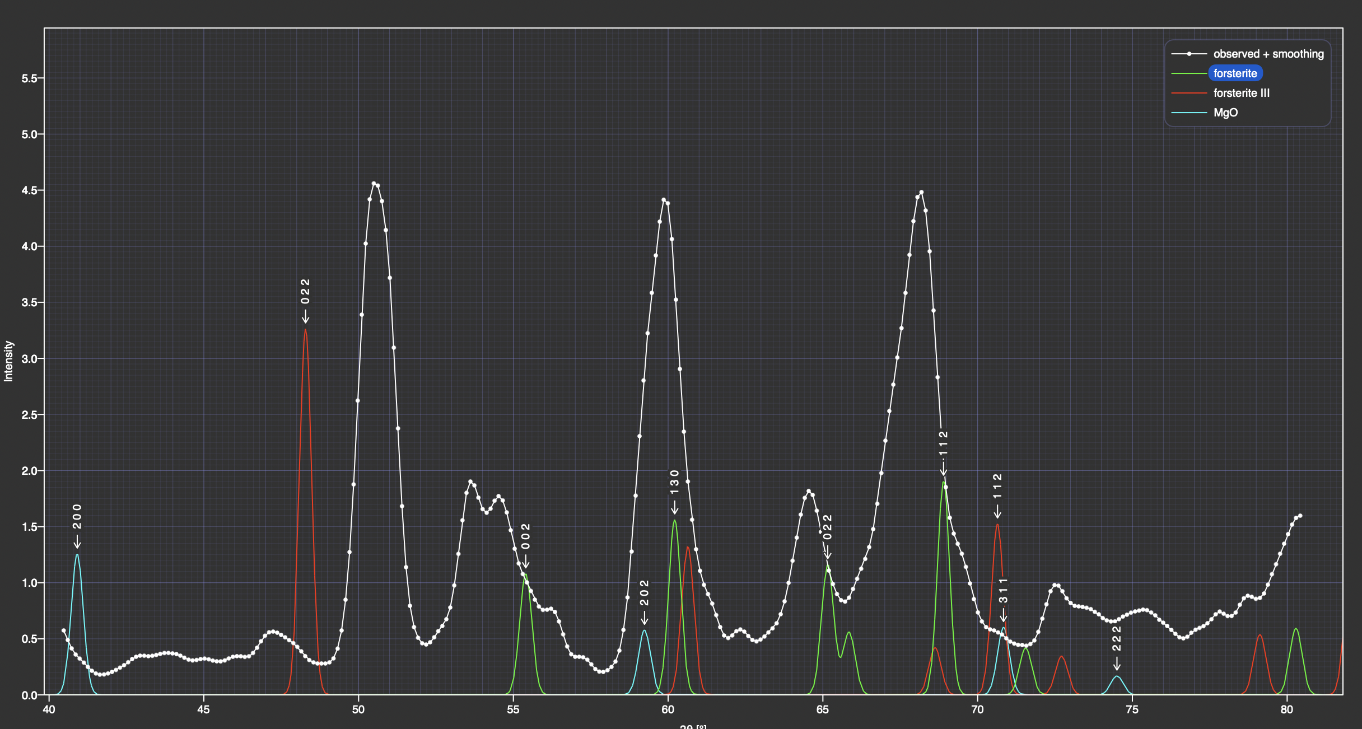
Results – Crystal diffract
Observed
Forsterite
Forsterite III
MgO
260 GPa
150 GPa
Notes:
Using the Crystal diffract software I overlaid diffraction data that I got with predicted diffraction patterns of the materials expected to be present in the experiment
Each peak of the white observed represents a diffraction peak that should be matching up with one of suspected materials
Now forsterite is our sample and MgO is what we’re looking for
Forsterite III is another solid-solid phase transition of forsterite, and has recently been proved in kim’s 2021 paper to be found in laser shock compression experiments
Because it is so recently proved, there is not a good experimental hugoniot out there, which may be why some of the peaks that can be attributed to forsterite III are not matching up exactly
In the lower pressure shot you can see that almost every peak lines up somewhere with some forsterite peaks
In the higher pressure shot 3 of them match up pretty well with forsterite while the red line, which appeared in just the 260 GPa one and wasn’t present in 150 GPa, matches up pretty well with an MgO peak

Slide 13
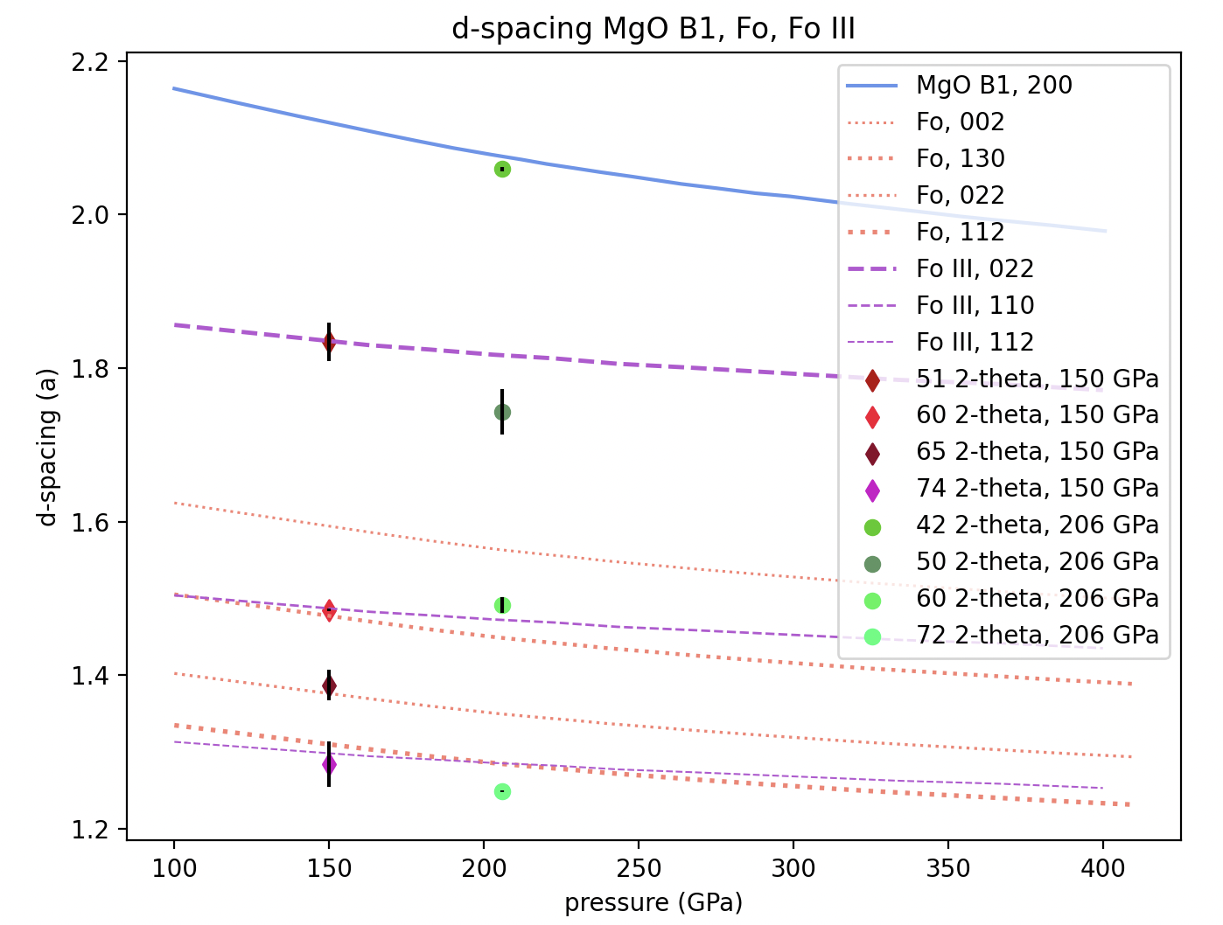
Results - d-spacing
Notes:
This is where I translated everything into d-spacing and it just further proves the results from crystal diffract
In all the lower pressure hsots, everything lines up very well with forsterite lines
In the higher pressure shot just the one diffraction peak lines up very well with an appearing MgO line
If we are seeing MgO that means that the forsterite lines will be lines of partially melted forsterite
When something melts its much broader and a more fuzzy peak which would explain why the diffraction points are not perfect on the d-spacing lines

Slide 14
Newman (2018)
MgO
Fo melt
Notes:
Just to remind everyone here’s the results from newman
His evidence was the emergence of the clear red mgo line
And fuzzy forsterite melt lines, and this is just a demonstration of what I said previously on how they’re melting

Slide 15
Results - PXRDIP
Strong Fo
Strong Fo melt
MgO
Fainter Fo
Fainter Fo melt
150 GPa
260 GPa
Notes:
Here are the results from the PXRDIP

Slide 16
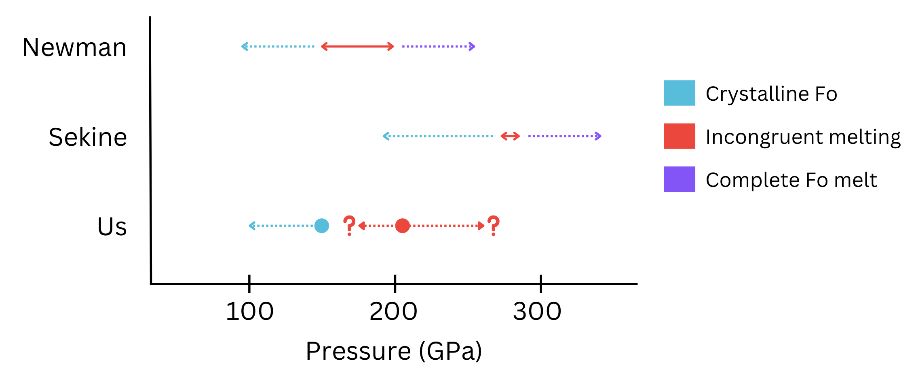
Conclusion
Hypothesis: incongruent melting is occurring at 150 or 206 GPa
The experiment conducted at 206 GPa shows signs of incongruent melting because of evidence implying the presence of crystal MgO and liquid forsterite
XRD results agree with Newman
Notes:
Just going back our hypothesis was that incongruent melting was happening at either 150 or 260
Therefore because of we saw forsterite melt lines and the emergence of MgO line in the higher pressure shot, it can be concluded that it shows signs of incongruent melting
The pressure range that we found agrees with Sekine, 271 to 285
Our x-ray diffraction results agree with newman’s dissertation, but found a different pressure range
In his experiments he argued that forsterite would be completely melted above 200 GPa, which we found that it was definitely not completely melted at 260 GPa
Remember that newman agreed with root, and both of those experiments used single-crystal forsterite
In our experiment we used powdered forsterite which may have caused the pressure range to be so drastically different

Slide 17
Next steps
Analyze VISAR data to verify the data from PXRDIP
Conduct more experiments to verify these findings
Redo the alignment, measure the diffraction lines in sample view not pinwarp view
Add uncertainty
Look for more accurate hugoniots or hugoniots with uncertainty

Slide 18
References
Sekine, T., Ozaki, N., Miyanishi, K., Asaumi, Y., Kimura, T., Albertazzi, B., ... & Kodama, R. (2016). Shock compression response of forsterite above 250 GPa. Science Advances, 2(8), e1600157.
Root, S., Townsend, J. P., Davies, E., Lemke, R. W., Bliss, D. E., Fratanduono, D. E., ... & Jacobsen, S. B. (2018). The principal Hugoniot of forsterite to 950 GPa. Geophysical Research Letters, 45(9), 3865-3872.
Kim, D., Tracy, S. J., Smith, R. F., Gleason, A. E., Bolme, C. A., Prakapenka, V. B., ... & Duffy, T. S. (2021). Femtosecond X‐ray Diffraction of Laser‐shocked Forsterite (Mg2SiO4) to 122 GPa. Journal of Geophysical Research: Solid Earth, 126(1), e2020JB020337.
Newman, M. G. (2018). On the Kinetics of Materials of Geophysical Interest (Order No. 30556695). Available from ProQuest Central; ProQuest Dissertations & Theses Global. (2838439956). https://doi.org/10.7907/Z9319T35 https://proxy1.library.jhu.edu/login?url=https://www.proquest.com/dissertations-theses/on-kinetics-materials-geophysical-interest/docview/2838439956/se-2
Wicks, J. K., Smith, R. F., Fratanduono, D. E., Coppari, F., Kraus, R. G., Newman, M. G., Rygg, J. R., Eggert, J. H., & Duffy, T. S. (2018). Crystal structure and equation of state of Fe-Si alloys at super-Earth core conditions. Science advances, 4(4), eaao5864. https://doi.org/10.1126/sciadv.aao5864

